Slide 1
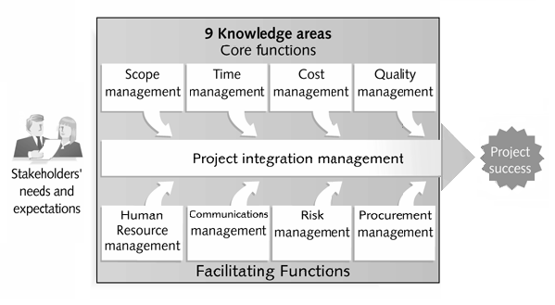
Project Management
Project Integration Management
(Nine Knowledge Areas including Project Integration Management)

Slide 2
Project Management Knowledge Area

Slide 3
Project Integration Management Overview
The integrative project management processes include:
  4.1 Develop Project Charter
  4.2 Develop Preliminary Project Scope Statement
  4.3 Develop Project Management Plan
  4.4 Direct and Manage Project Execution
  4.5 Monitor and Control Project Work
  4.6 Integrated Change Control
  4.7 Close Project

Slide 4
Develop Project Charter
  The project charter provides the project manager with the authority to apply organizational resources to project activities.
The project charter is the document that formally authorizes a project, driven by strategic needs, such as:
  A market demand
  A business need
  A customer request
  A technological advance
  A legal requirement
  A social need

Slide 5
Develop Project Charter
The project charter, either directly, or by reference to other documents, should address the following information:
  Requirements that satisfy customer, sponsor, and other stakeholder needs, wants and expectations
  Business needs, high-level project description, or product requirements that the project is undertaken to address
  Project purpose or justification
  Assigned project manager and authority level
  Summary milestone schedule
  Stakeholder influences
  Functional organizations and their participation
  Organizational, environmental and external assumptions
  Organizational, environmental and external constraints
  Business case justifying the project, including return on investment
  Summary budget.

Slide 6
Develop Project Charter
Inputs:
Contract (When Applicable)
Project Statement of Work
Enterprise Environmental Factors
Organizational Process Assets
Tools and Techniques:
Project Selection Methodology
Project Management Methodology
Project Management Information System
Expert Judgment
Output:
Project Charter

Slide 7
Develop Project Charter: Input
Contract (When Applicable):
A contract from the customer’s acquiring organization is an input if the project is being done for an external customer.
Project Statement of Work (PSOW):
The Statement of work is a narrative description of products or services to be supplied by the project. For internal projects, the project initiator or sponsor provides the SOW based on business needs, product, or service requirements. For external projects, the SOW can be received from the customer as part of a bid document, for example, request for proposal, request for information, request for bid.

Slide 8
Develop Project Charter: Input
Enterprise Environmental Factors:
When developing the project charter, any and all of the organization’s enterprise environmental factors and systems that surround and influence the project’s success must be considered. This includes items such as,
Organizational culture and structure.
Governmental or industry standards (e.g., regulatory agency regulations, product standards, quality standards)
Infrastructure
Existing Human Resource
Personnel Administration (e.g., hiring and firing guidelines, training records)
Company work authorization system

Slide 9
Develop Project Charter: Input
Organizational Process Assets:
When developing the project charter and subsequent project documentation, any and all of the assets that are used to influence the project’s success can be drawn from organizational process assets. Organizational process assets also represent the organizations’ learning and knowledge from previous projects; for example, completed schedules, risk data and earned value data. Organizational process assets can be organized differently, depending on the type of industry, organization and application area.

Slide 10
Develop Project Charter: Tools and Techniques
Project Selection Method:
Project selection methods are used to determine which project the organization will select. These methodology fall into one of two broad categories:
Benefit measurement methods that are comparative approaches, scoring models, benefit contribution or economic model (Qualitative Approach)
Mathematical models that use linear, nonlinear, dynamic, integer. (Quantitative Method)

Slide 11
Develop Project Charter: Tools and Techniques
Project Management Methodology:
A project management methodology defines a set of PM Groups, their related processes and the related control functions that are consolidated and combined into functioning unified whole. A PM methodology can be either a formal mature process or an informal technique that aids a project management team in effectively developing a project charter.
PM Information System:
The Project Management Information System (PMIS) is a standardized set of automated tools available within the organization and integrated into a system. The PMIS is used by the PM team to support generation of a project charter, facilitate feedback as the document is refined.

Slide 12
Develop Project Charter: Tools and Techniques
Expert Judgment:
Expert judgment is often used to asses the inputs needed to develop the project charter. Such judgment and expertise is applied to any technical and management details during this process. Those expertise includes:
Other units within organization
Consultants
Stakeholders, including customers and sponsors
Professional and technical associations
Industry Group
Output:
Project Charter

